Slide 1
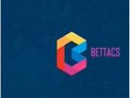
Main Activities
Human Resource Executive.
HR Policies
Setting HR policies and ensure compliance from staff.
Training and Development
Recruitment
Effective planning and forecast of the workforce.
Adequate training and development and managment of workforce .
Human
Resource Executive
Redundancy and Compensation
Teamwork
Ensured the team carried out their tasks in line with the project objectives.
Adequate handling of redundancy and compensation of staff.
Wages
Determine workers’annual wages.
Prepared by: Taiwo Amao (201624009)

Slide 2
Main Activities
Key Performance Indicators.
KPI
Productivity Index
Number of Strikes
Training Costs
Labour cost
Prepared by: Taiwo Amao (201624009)
Notes:
Key Performance Indicators (KPIs) are useful in workforce planning and improving performance in the company.

Slide 3
HR Analysis
Number of Strike days
Insights
The figure 1. shows number of stike days in the company. In year 1, it was 2 days and reduced to 1 day in year 2. It increased back to 2 days in year 3. The Strike days were at the highest in year 4 at 46 days due to closure of a plant. And year 5 had 37 days of strike. The strike days reduced to 2 days at the end of the round in year 6.
Figure 1.
Prepared by: Taiwo Amao (201624009)
Notes:
The company incurred £46.85 million in year 4 and £4.60 million in year 5 on redundancy cost due to the strike.

Slide 4
Analysis
Workforce and Automation
Figure 2
Insights
Figure 2 shows BETTACS recruited the highest workforce of 7600 workers in year 3 and also 7239 workforce in year 2. The number of workforce fell to 1200 in year 4 due to a plant closure and also recorded a fall in year 5 to 571 workers. There was an increase in the workforce in year 6 to 2227 workers.
Insights
Figure 3 shows BETTACS had the highest investment of £410 million in year 2 and year 3 was £300 million. The company had the lowest investment of £3 million in year 5. In year 6, the automation expenditure increased to £101 million.
Figure 3
Prepared by: Taiwo Amao (201624009)

Slide 5
Analysis
Productivity Index
Figure 4
Insights
Figure 4 shows the project had 0.90 productivity index in year 1 and increased to 0.99 in Year 2. Year 3 had the highest level of 2.05 productivity index. It fell in year 4 to 1.2 and increased in year 5 to 1.46. The company closed with a productivity index level of 1.41.
Prepared by: Taiwo Amao (201624009)

Slide 6
Analysis
Wage Cost Training Cost
Figure 5 Figure 6
The figure 6 above shows that £6.5 million was the highest amount spent on training in year 3, and £5.52 million in year 2. In year 4 the record fell to £1 million. The lowest amount was £0.5 million in year 5, and increased to £ 1 million in year 6.
The above figure 5 shows that in year 2 BETTACS spent highest amount of £253.37 million on wages, and £247 million in Year 3. The lowest amount spent was £15.97 million in year 5.
Prepared by: Taiwo Amao (201624009)

Slide 7
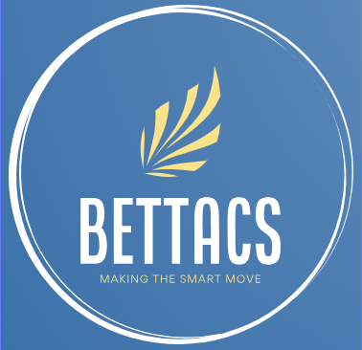
Conclusions
Self-Reflections –Taiwo Amao
Teamwork
Business simulation game
Lessons Learned
Suggested Improvements
Each member of the team contributed to the success of the project. Although, some decisions taken were not wise decisions and it affected the company’s profit and the labor turnover of the project. There was effective communication in the team through regular team meetings and efficient contributions. The team members contributed well to decision-making during the game. The team demonstrated good intra- personal and active listening skills. Although, there was always conflict in concluding a decision during the game simulation.
Business simulation activities provide an opportunity for practical learning. It allows business analytics to be used in analysing the simulation result. The analytical tool was used to decide and predict the simulation game's next steps (Rabia and Bellabdaoui, 2020).
Inadequate planning, no proper research was carried out before the start of the simulation. Going by the market research, other competitors invested in small cars with petrol, which increased the company's profit. However, the company's objectives were to make profit and ensure sustainability. During the game simulation, the focus was just on the objectives without consideration of the workforce in terms of staff morale. There was a high rate of strike days in year 4 and 5 due to closure of a plant, this affected the profits of the company and this incurred redundancy costs.
Investing in a good model like the small car would have been a good investment from the start of the project and could have increased the company's profits. The team invested wrongly by spending heavily in year 3, which led to a plant closure in the following year. The company was focused on producing sustainable products in the options, but there was a slight change in the options in rounds 5 and 6. The company went for petrol options, and this was based on the result of rival companies that made more profit going for petrol. For future simulations, the decisions on hybrid should be maintained, allowing the company to produce responsibly.
Prepared by: Taiwo Amao (201624009)

